Slide 1
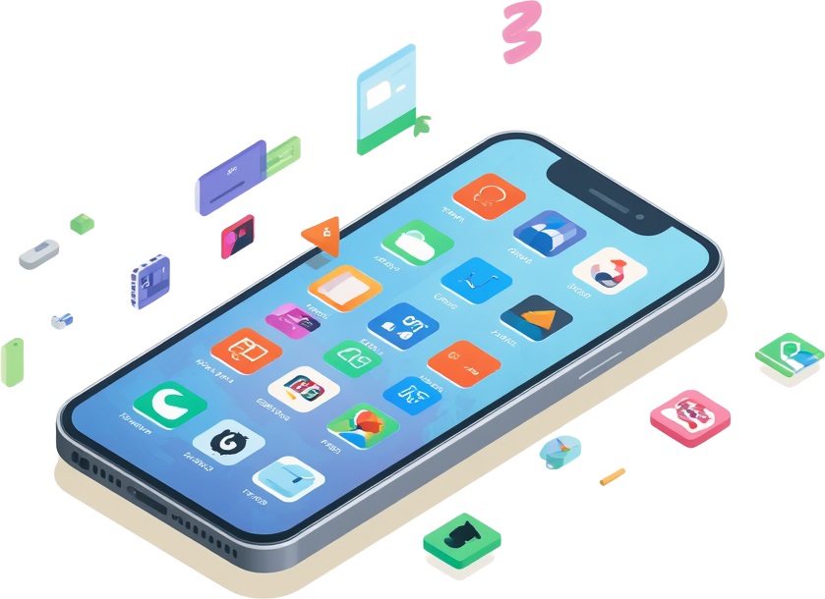
UI & UX Analysis

Slide 2
WHAT IS UI?
UI stands for User Interface. It is the visual or tactile space where a human interacts with a machine, software, or website. It includes all the elements you see and click, such as screens, buttons, menus, icons, typography, and colors. [1, 2, 3, 4, 5]

Slide 3
WHAT IS UX?
UX stands for User Experience. It refers to how a person feels and behaves when interacting with a product, service, or system. Good UX ensures the interaction is intuitive, efficient, and enjoyable, removing frustration and friction.

Slide 4
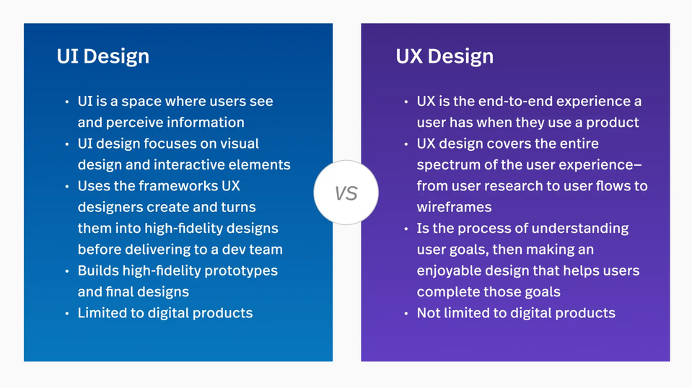
UI VS UX

Slide 5
APP INTRODUCTION
PINTEREST
AMAZON
SPOTIFY
CHROME
GPAY

Slide 6


Pinterest UI/UX
1
2
3
UI Elements: Masonry grid layout, Pin cards with image & title, floating action button, bottom nav bar, and category pills for filtering.
UX Features: Visual discovery engine, infinite scroll feed, smart search bar with visual suggestions, and personalized home feed based on interests.
Key UX Insight: Seamless Save & Board organization, hover-to-preview interactions, and related Pin recommendations drive deep user engagement.
UX Rating:

Slide 7


Amazon UI/UX
2
3
1
Cart & Buy Button: Persistent cart icon, "Add to Cart" vs "Buy Now" CTAs, and a streamlined 1-click checkout e-commerce flow.
Product Cards: Image, title, price, star ratings, and Prime badge. Scannable layout for quick browsing decisions.
Search & Filters: Smart search bar with auto-suggestions, category filters, price range sliders, and sort options for refined UX flow.
UX Rating:

Slide 8


Spotify UI/UX Elements
1
2
3
Play Controls: Intuitive playback bar with shuffle, repeat, skip, and play/pause buttons. Mini-player persists across screens for seamless audio streaming UX.
Playlist Cards: Grid and list-style cards with cover art and titles. Personalized recommendations via "Made For You" improve discoverability and user retention.
Navigation Tabs: Bottom nav bar with Home, Search, and Library tabs for quick access. Album Art displayed prominently on Now Playing screen enhances visual engagement.
UX Rating:

Slide 9


Chrome
UI/UX Elements
Address bar (Omnibox), Tab system, Bookmarks bar, Extensions toolbar, Incognito mode, Minimalist & clean browser UX design.
UX Rating :

Slide 10

GPay
UI/UX Elements
QR Scanner, Payment Buttons, Transaction History, Contact Chips & Secure Payment UX patterns that define Google Pay's seamless experience.
UX Rating:

Slide 11
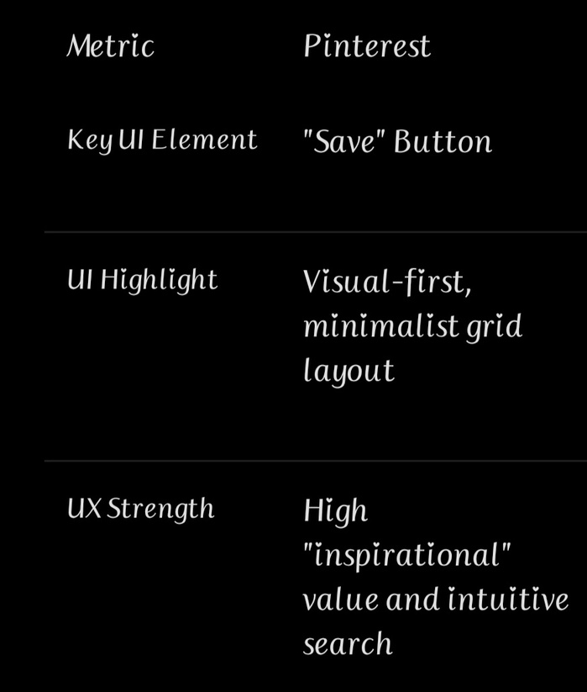
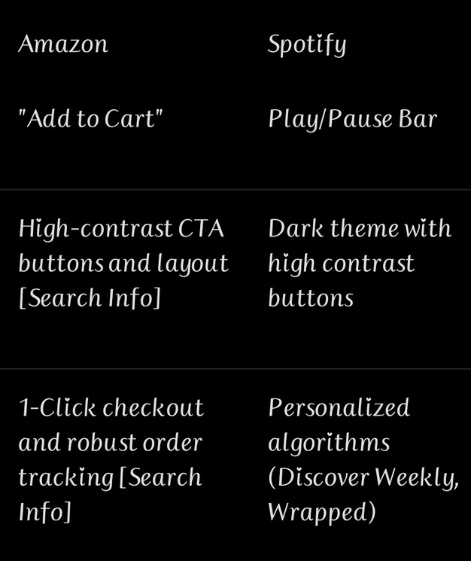
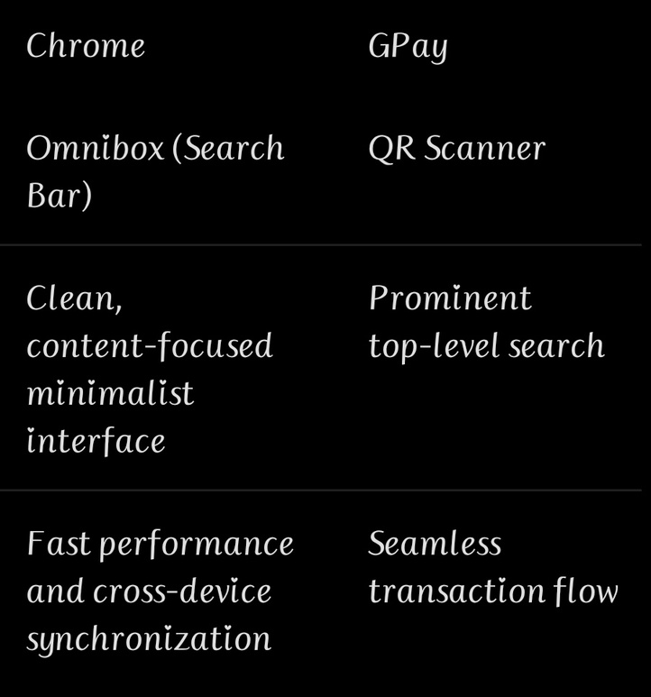
SUMMARY-UI&UX ANALYSIS

Slide 12
THANK YOU

